Slide 1
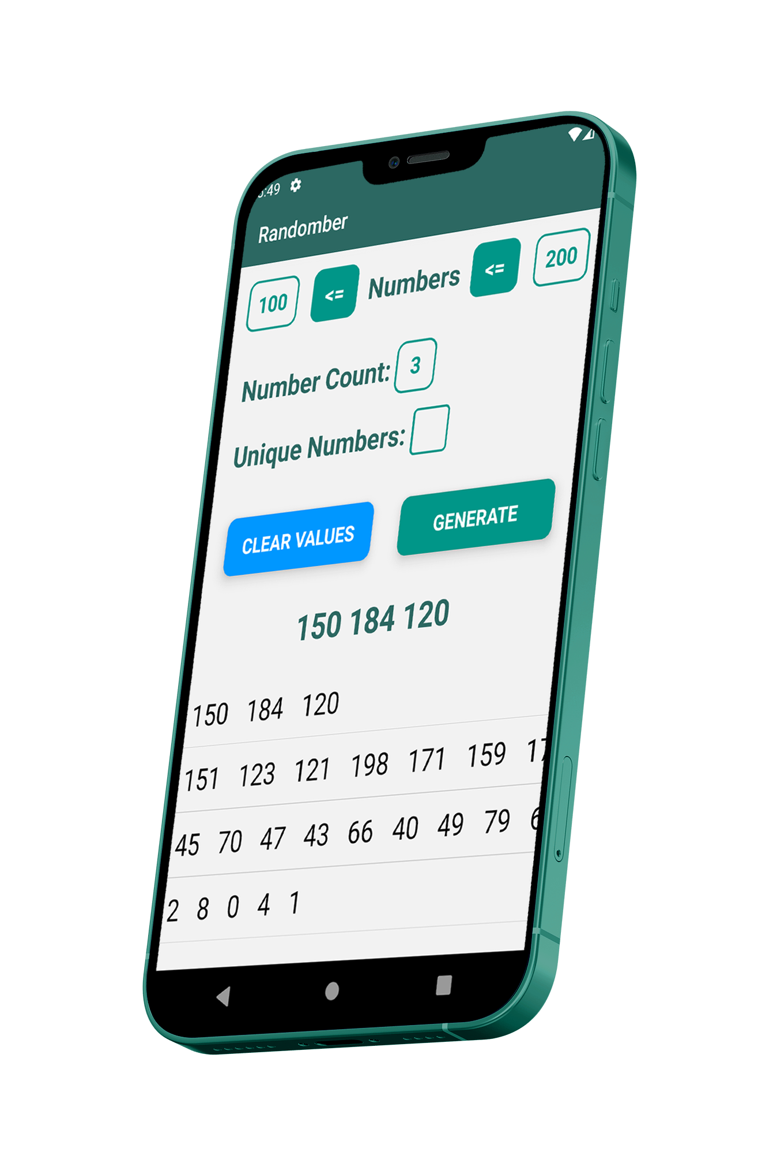


Randomber
1191602003 – Gürkan UÇAR
Cem TAŞKIN – Mobile Lesson Final Exam

Slide 2
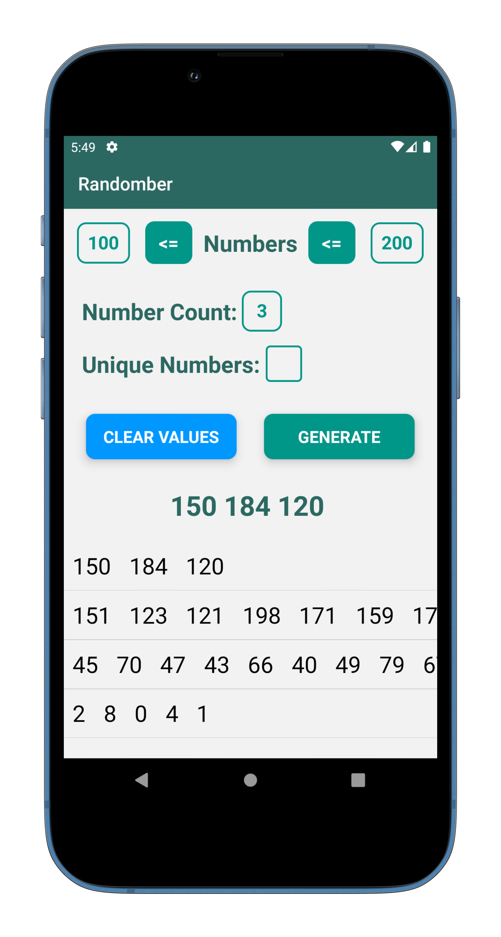
Features
Generate random numbers
Adjust constraints (< > <= >=)
Generate as many random numbers as you want
Make them unique
View history

Slide 3
Swap constraints automatically
if your constraints are not at the correct place, we are swapping automatically!

Slide 4
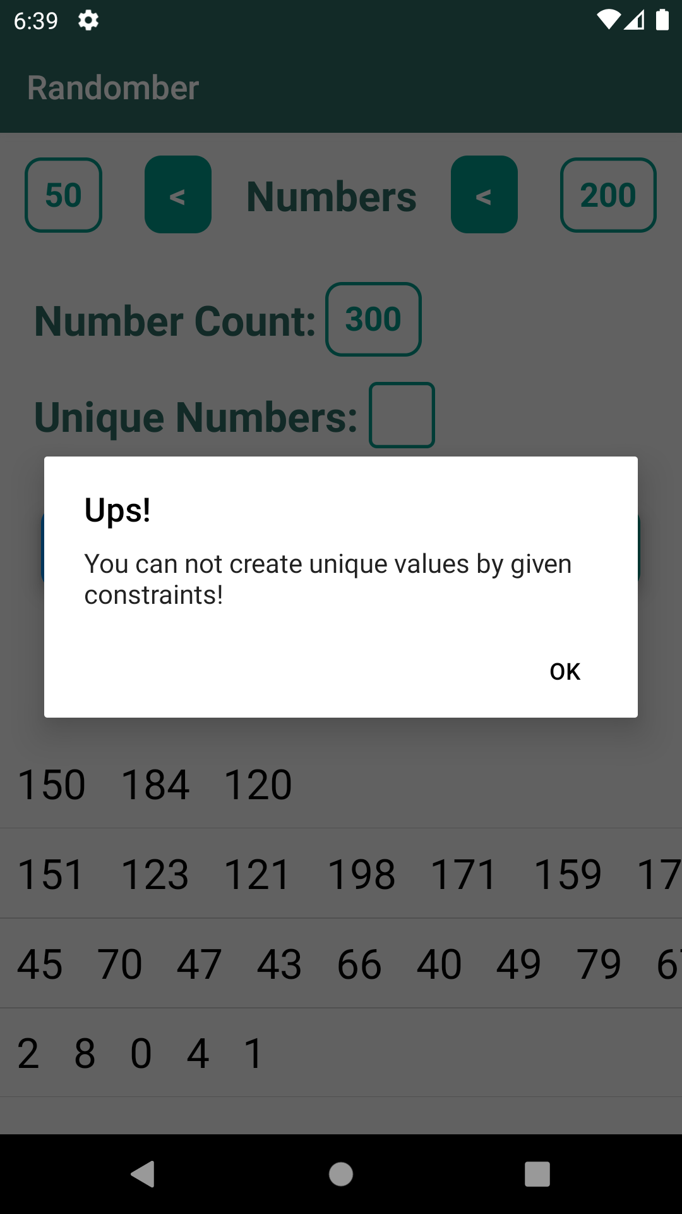
Handle possible logical errors
If your number range is not appropriate for unique numbers you will get an error

Slide 5
Possible Errors
Constraint Error
Unique Number Error
Number Count Error
X>Y: X < numbers < Y
X < numbers < X
X < numbers < X+1
X < numbers <= X+1
X <= numbers < X+1
X>Y: Y < numbers < X
X <= numbers <=X+1
n = wanted_number_count
X = min, Y=max
n <= Y – X + 1
Ex: x=3, y=6, n=5
n = wanted_number_count
n > 0

Slide 6



Tech Stack
Created using React Native Expo
Packages:
@react-navigation: navigate between screens
expo-checkbox: checkbox component
expo-status-bar: customize status bar
react-native-gesture-handler: gesture tracking

Slide 7
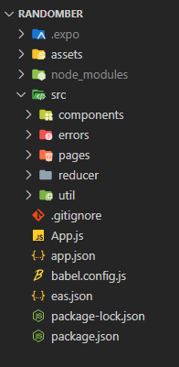
Project Structure
components
Our custom components under this package
errors
Includes error message constants
pages
Pages for navigation
reducer
Our reducer codes in here
util
Utility codes like “generate random number” function in here

Slide 8
Demo

Slide 9
Thanks!
https://github.com/gurkanucar

